Slide 1
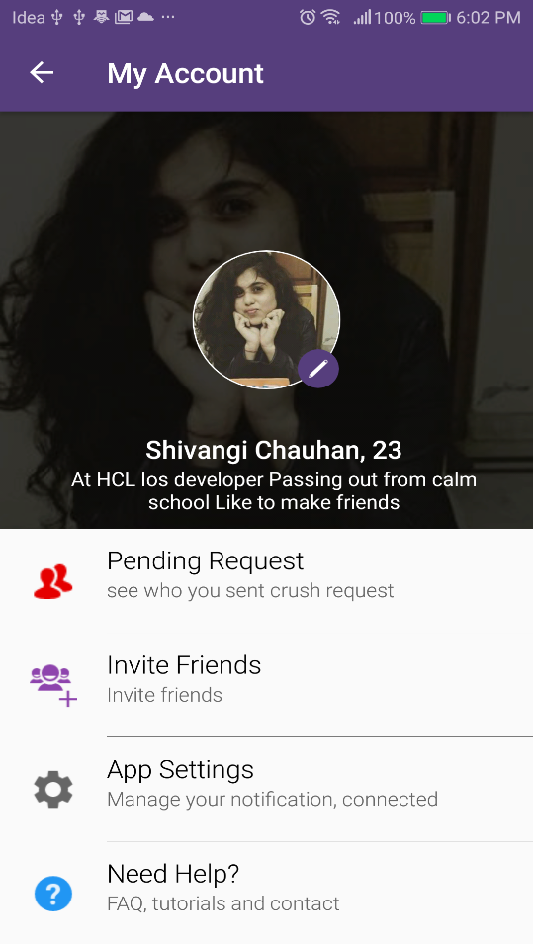
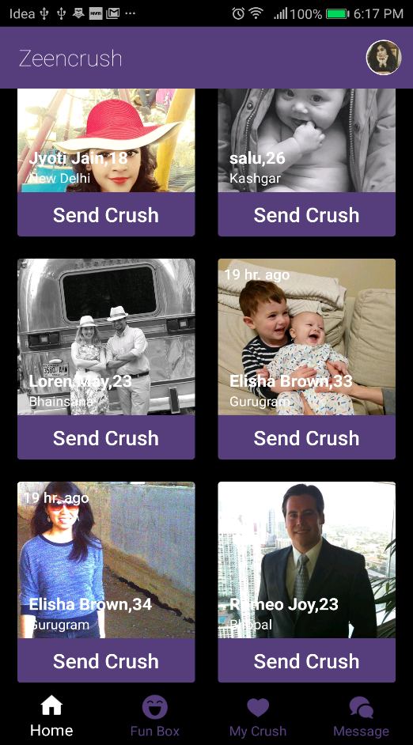
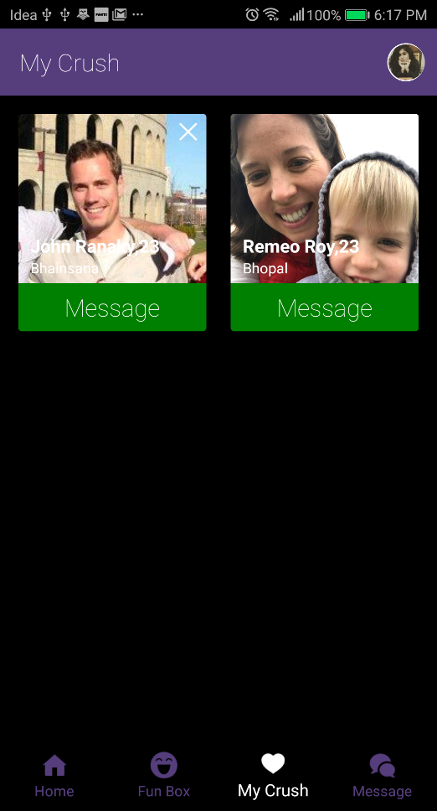
You an manage your profile
in account section
Send crush request from
Your dashboard
After accept request you
can chat with them

Slide 2
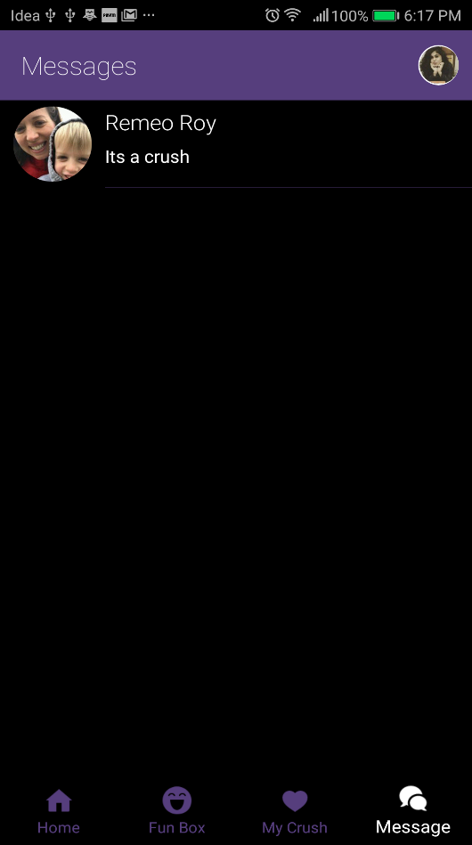
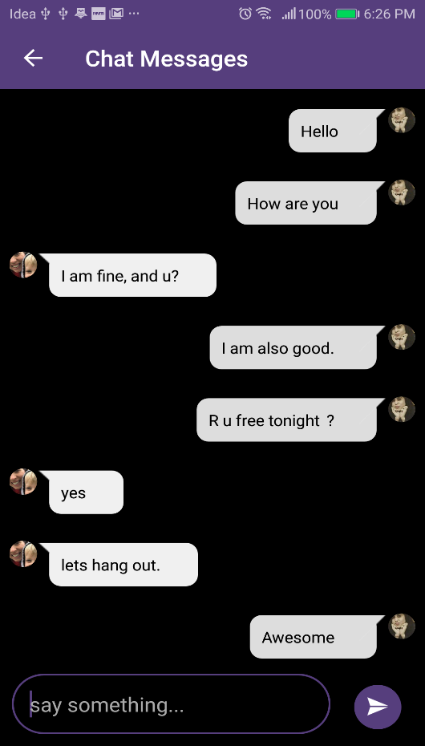
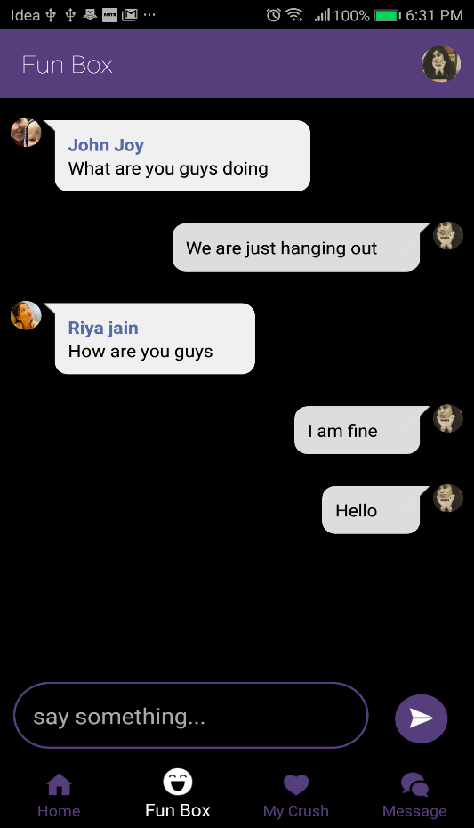
On message section will
Will show your messages
You can chat with your
crush in secured thread
In Fun Box you can group
chat with zencrush people

